Slide 1

TEAM-14
CMPE272
PROF. RANJAN

Slide 2

BUSINESS RESOURCE CENTER

Slide 3

WHAT IS A BUSINESS RESOURCE CENTER??
Helps local businesses with required resources.
Resources are contributed by students.

Slide 4

CURRENT CHALLENGE
Local businesses lack expertise and guidance.
Cannot afford to partner with Big Consultancies.

Slide 5

WHAT ARE WE SOLVING??
Local businesses can post their challenges online.
Students of SJSU can provide solution to these problems.

Slide 6
ADVANTAGES
Local businesses can benefit a lot from these cost effective approaches.
Students will gain exposure to the current challenges being faced in industries.
Cost Effective
Innovative Services
Students get exposed to real world problems

Slide 7
Technologies Used
MongoDB
ExpressJS
AWS
ReactJS
NodeJS

Slide 8
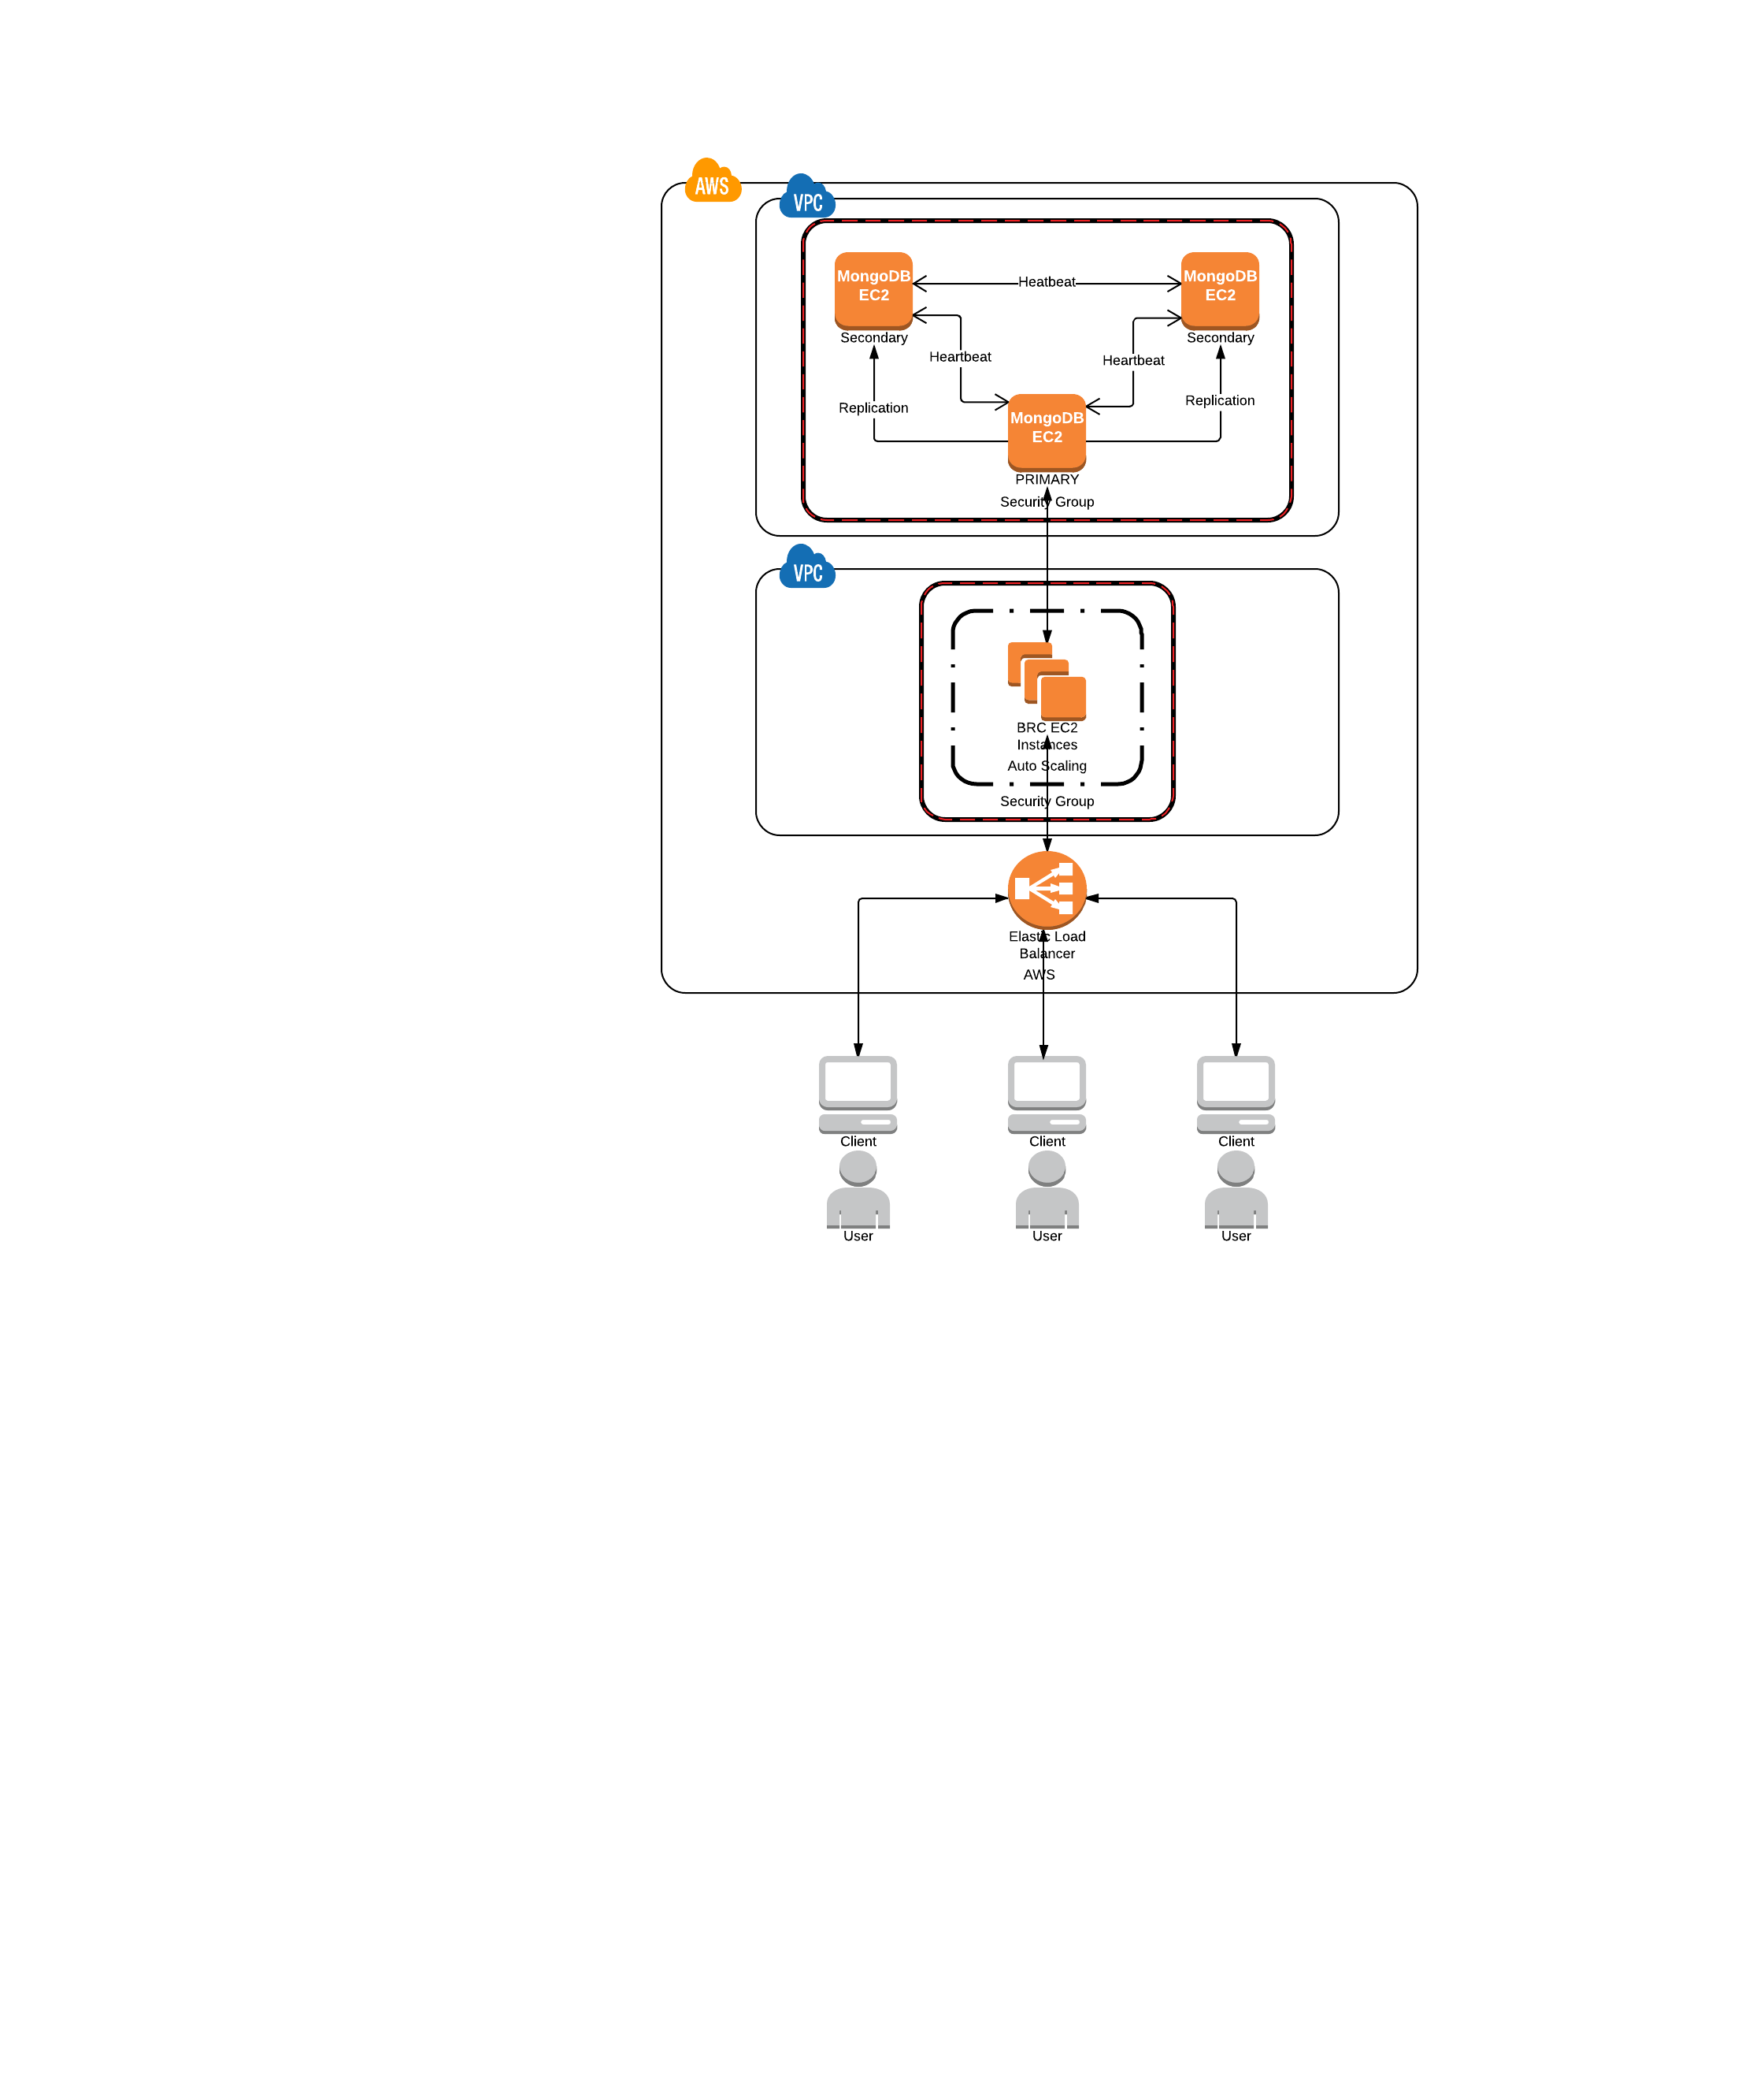
Architecture on AWS

Slide 9
THANK YOU!!!
Team Members
ABHIJITSINH CHAVDA
AKASH GUPTA
HARI KRISHNA PARIVEDA
ARSHIYA SETHI

